Slide 1

Go to market and cost drivers
EE3L11 – Workshop 2
Delft Centre for Entrepreneurship
www.tudelft.nl/dce/education

Slide 2
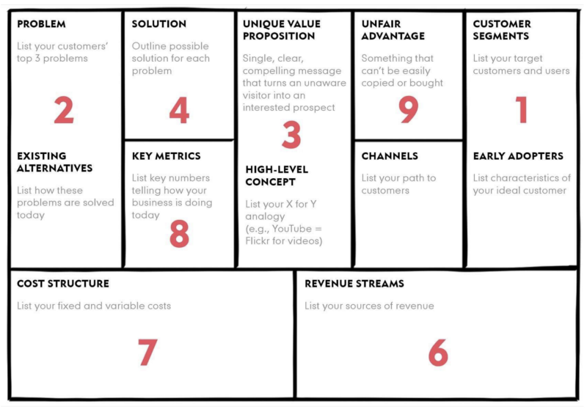
Lean Business Model Canvas

Slide 3
Lean Business Model Canvas

Slide 4
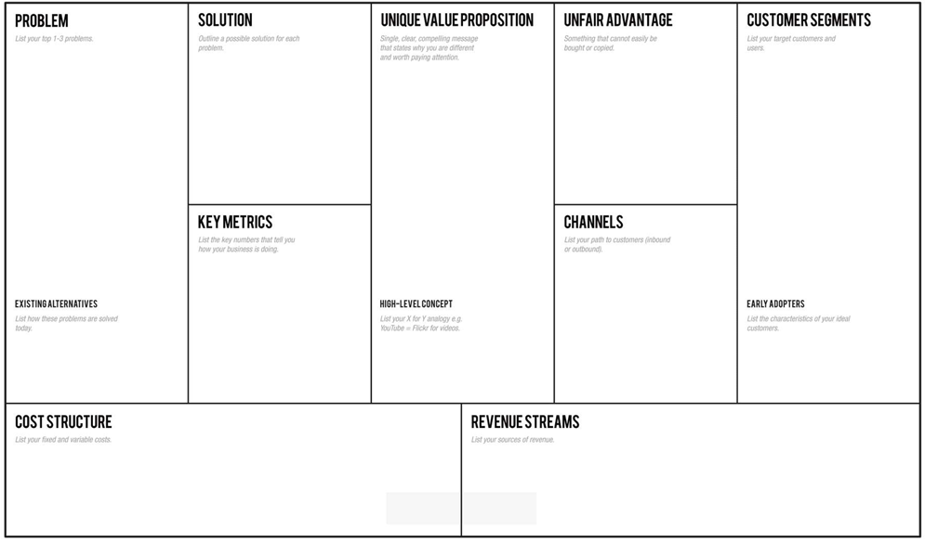
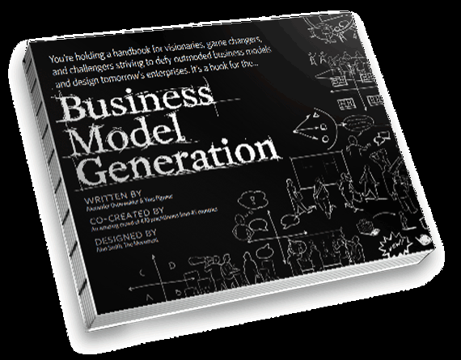
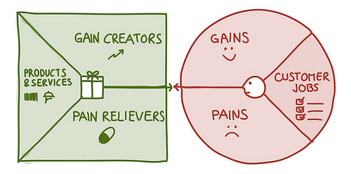
Value Proposition Canvas

Slide 5
Value Proposition Canvas
Technology / solution
Users / customers

Slide 6
Lean Business Model Canvas

Slide 7
Channels
Go to market plan
get in touch with my main user
For an entrepreneur, to get in contact with customers
For a researcher, to get in contact with research groups
For a consultant to advice policy, to get in contact with a policymaker
Get to know your persona, what is important to them
How do they make decision to use
And who is involved in making that decision?

Slide 8
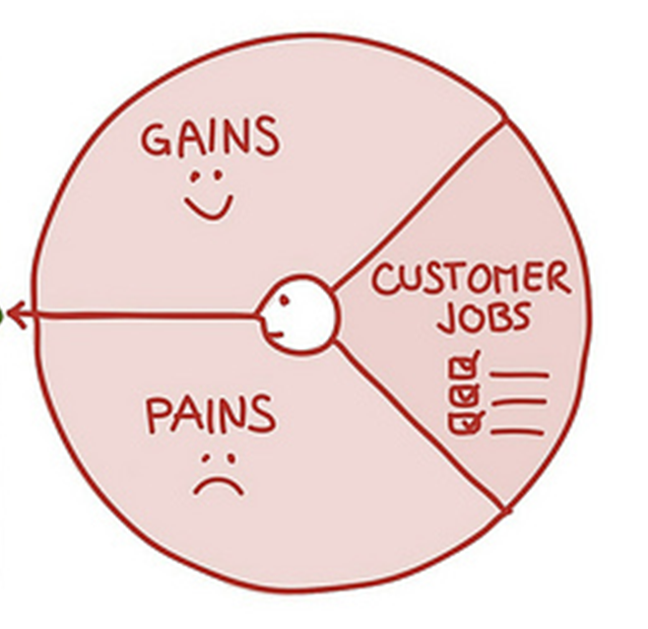
Channels ➔ plan to go to market
Go to market plan
Get to know your persona
How do they use the product, the solution, the technology
Know about the solution
Evaluate the solution
Install the solution
Use the solution
Spread the word

Slide 9
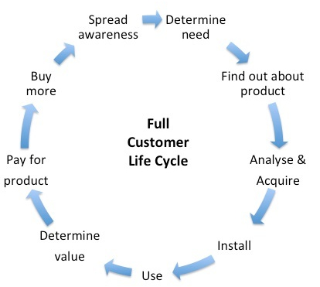
For all: Full customer life cycle
To understand your persona
What can we do for the persona
It is about activating your persona
Full Cycle Use Cases describe customer’s
How do customers know that they want it
How do they know where to get it
How do they decide to use it
How do they pay for it
How do they tell others, it is great

Slide 10
Full customer life cycle
Describe in detail how the user knows about your product, gets value from it, pays for it and tells others about it.
The following factors are all essential parts of the Full Life Cycle Use Case:
How end users will determine their need and/or opportunity to do something different.
How they will find out about your product.
How they will analyze your product.
How they will acquire your product.
How they will install your product.
How they will use your product.
How they will determine the value gained from your product.
How they will pay for your product.
How they will receive support for your product.
How they will buy more product and/or spread awareness (hopefully positive) about your product.

Slide 11
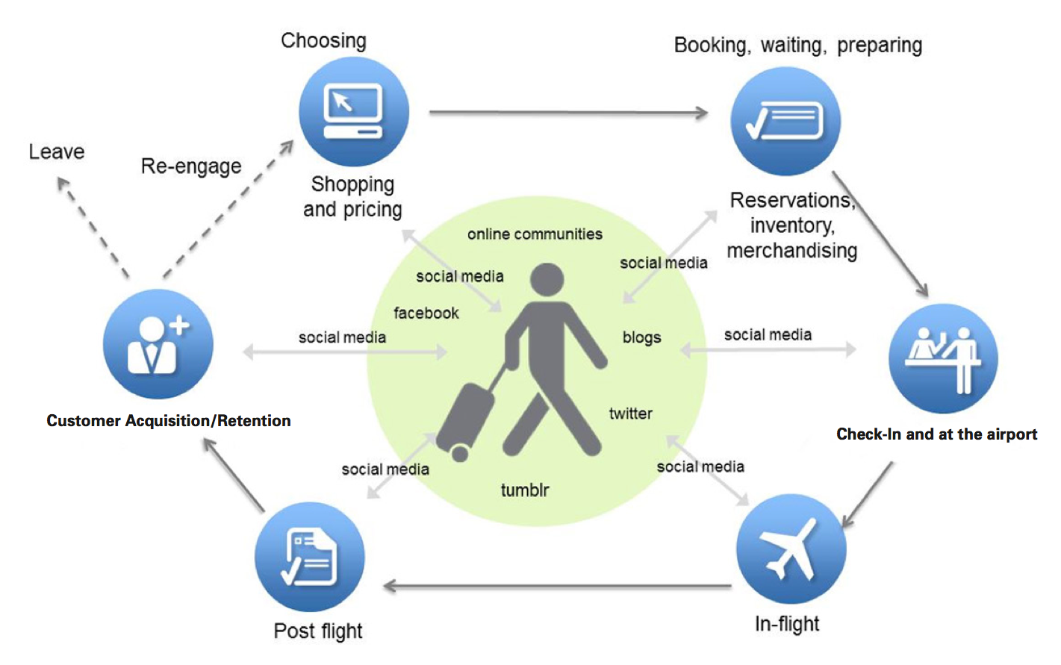
Full customer life cycle
The Full Life Cycle Use Case should be visual, using diagrams, flowcharts, or other methods that show sequence.

Slide 12
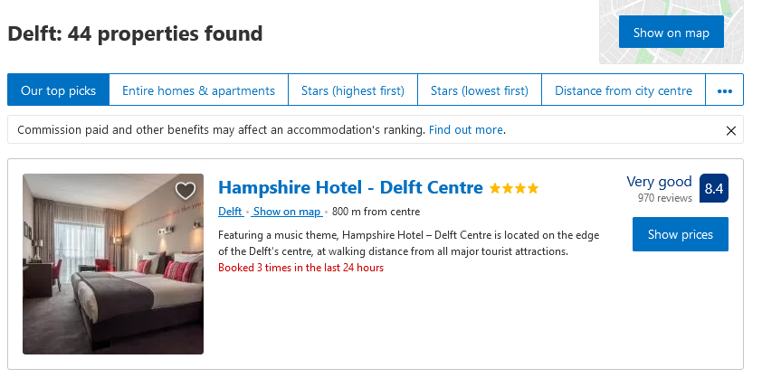
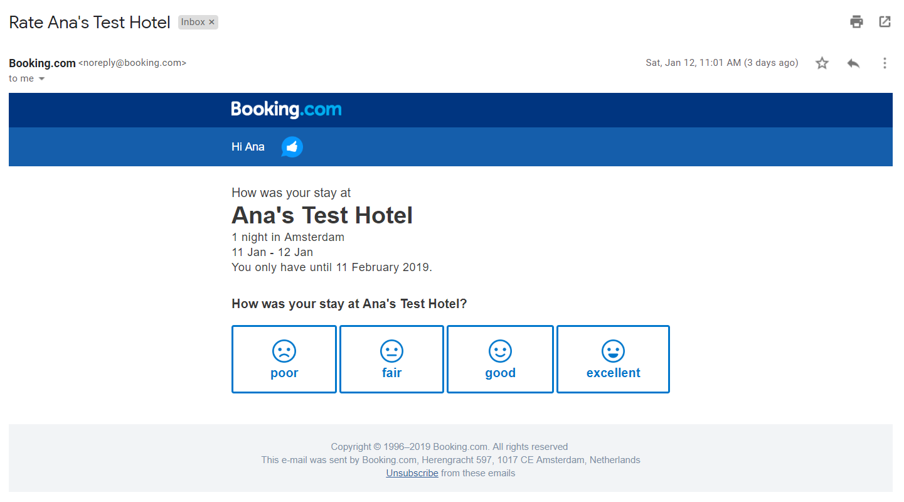
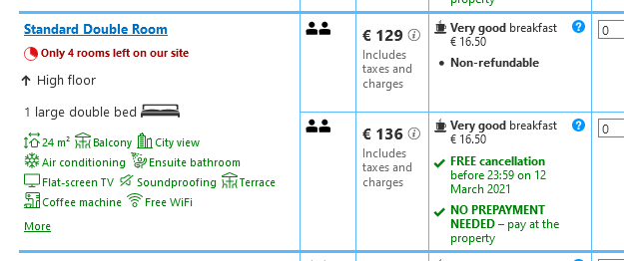
Full customer life cycle
The Full Life Cycle Use Case should be visual, using diagrams, flowcharts, or other methods that show sequence.

Slide 13

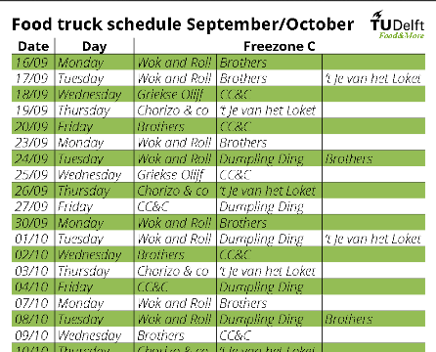


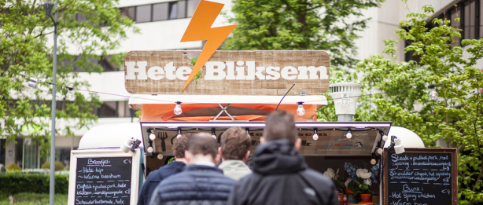
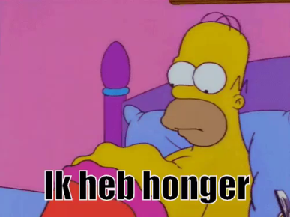
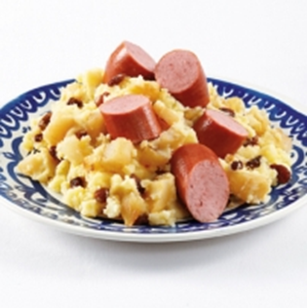
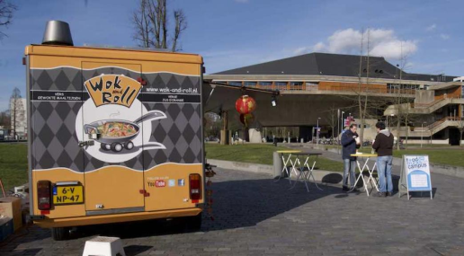

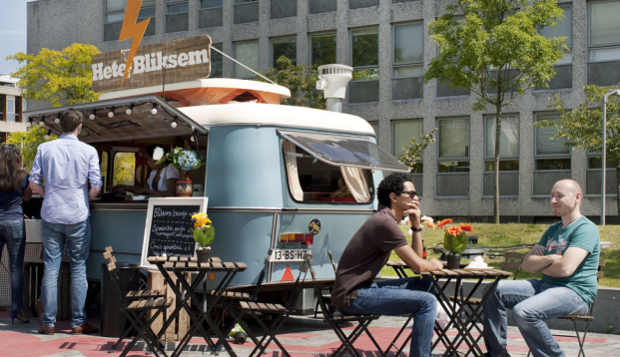
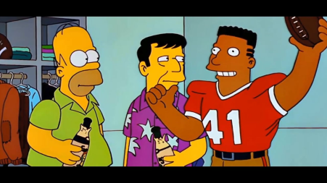
Full customer life cycle

Slide 14
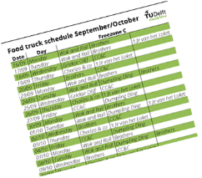


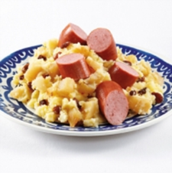
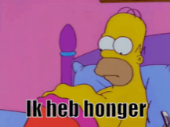




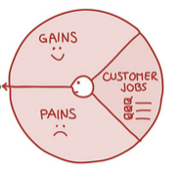
Full customer life cycle
Now that you know the use life cycle, we focus on where we can improve and add value ➔ search the touchpoints

Slide 15
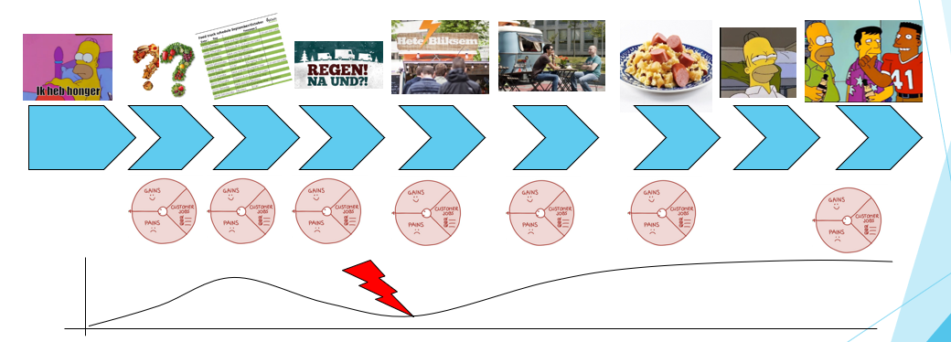
Full customer life cycle
Map a customer journey
For your idea, define all the “moments of truth” or touchpoints during a customer interaction or typical transaction.
Which touchpoints do you emphasize and reinforce?
What touchpoints do you de-emphasize but may be important to the consumer?
Is there an opportunity to improve, any misalignment you can fix?

Slide 16
Map the customer Journey
Full customer life cycle
Touchpoint | User Viewpoint | Customer Viewpoint | Opportunity for improvement?
I am hungry
What are my options
Where is information
What is the weather
Is there a que?
Can I sit with friends
Do I like the food
How long do I enjoy
Do I tell friends

Slide 17
Get to know your user: Journey Mapping
Do we understand all of the “moments of truth” from a user’s perspective?
Do we meet or exceed expectations at every moment of truth?
If not, are there opportunities for innovation in the full life cycle?
Are there unmet needs?

Slide 18
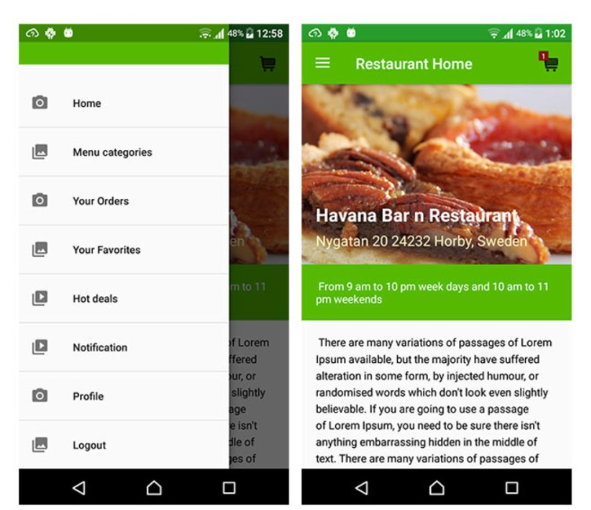


High-Level Product Specification
Draw sketches or visuals how it will look like

Slide 19

High-Level Product Specification
Draw up a brochure
Even if you will never use it
So why?
Makes it easy to communicate
Gives a focus on the user/ customer
Forces you to distinguish from others

Slide 20
Again look at the early steps
Value proposition canvas ➔ the pain and solution ➔ pricing
Select the Beachhead
- easy entry, option to learn and possibility to grow
Build an end user profile
Clear understanding of the user business case
What is the value you bring ➔ build a user business case
TAM versus SAM
- Total addressable market and what you can serve (SAM) in the first couple of years
- Develop good arguments for segmentation and market size/ growth

Slide 21
Cost of Marketing : How do users know about your offer?
What steps does a customer take to make a buy
Identify all the costs of sales and marketing
Brochures, flyers, salaries of salespeople, trade shows
Changing people in the DMU, new manager comes in
Identify the costs for the short, medium and long term
Make sure every effort is targeted at your user group

Slide 22
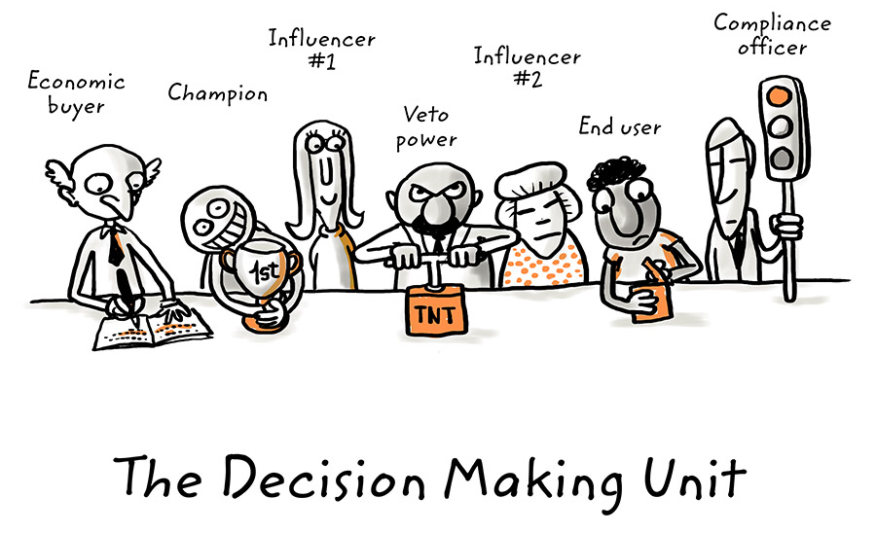
Decision Making Unit (DMU)

Slide 23

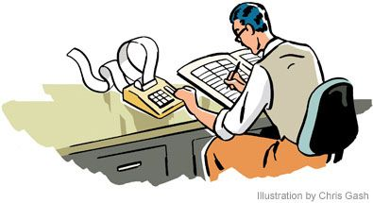
Decision Making Unit of your customer
You target a user, but whom?
End User: the person that actually uses/ needs the product or service
Initiator/ Champion: Identifies the problem that needs to be overcome
Gatekeeper: Provides and denies access to the members of the DMU, but may also forward information
Influencer: Is not directly responsible for the decision but has significant influence on it
Economic decider: The individual that makes the final decision to buy or not, typically budget holder
Purchaser (department) carries out the buying process, negotiaties

Slide 24
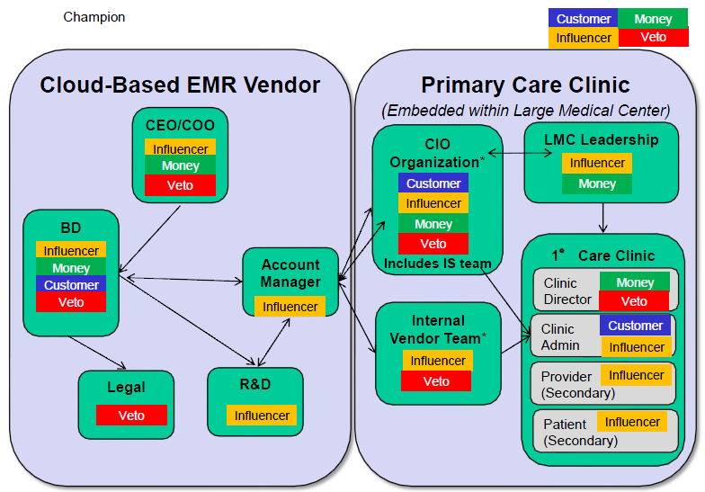
Decision Making Unit of your User
electronic medical records (EMR)

Slide 25
Time and Cost of getting to your user
 |  |  |  |  | Costs of a sale:
 |  |  |  |  | Prospect 1 |  | Prospect 2 |  | Prospect 3 |  | Prospect 4
1 | Appointment | Desk research | 0,3
 |  | Phone | 0,2
 |  | Travel | 1
 |  | Preso | 1
 |  | Follow-up | 0,1 |  | 2,6 |  | 2,6 |  | 2,6 |  | 2,6
2 | Fullfillment | Internal discussion | 0,2
 |  | Letter/Mail | 0,2 |  | 0,4 |  | 0,4 |  | 0,4 |  | 0,4
3 | 2nd appointment | Phone | 0,2
 |  | Travel | 1
 |  | Preso | 1
 |  | Follow-up | 0,1 |  | 2,3 |  | 2,3 |  | 2,3 |  | X
4 | Proposal | Desk research | 0,6
 |  | Internal discussion | 2
 |  | Production | 2
 |  | Accompanying letter | 1 |  | 5,6 |  | 5,6 |  | 5,6
5 | Endgame | External discussion | 0,2 |  | 0,2 |  | 0,2 |  | 0,2
 |  | Travel | 1 |  |  |  | x |  | x
 |  | Signing | 1 |  | 2
 |  | No of Hours: |  |  | 38,3

Slide 26
Sales process – Time and Cost of customer Acquisition
How many clients do you think you can address and convince to purchase?
How long will it take, what are the costs involved?
Marketing costs: how do customers know about the product/ service
(salary, brochures, trade shows, website, advertorials, …)
Clients that buy and that don’t
Conversion rate of clients reached and who will become a customer
Sales costs: costs of installing and servicing a customer
Installation cost: How long does implementation take? Is your product compatible?
What service/ maintenance do you provide?
7-3

Slide 27
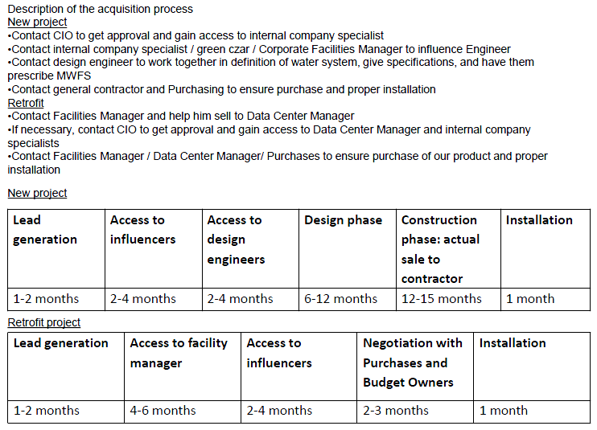
Sales process – Cost of customer Acquisition

Slide 28
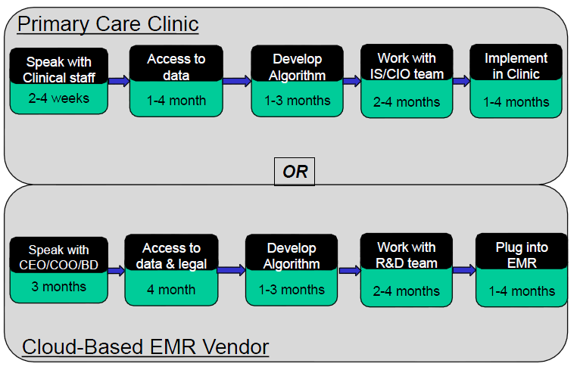
The sales process to reach your buyer
electronic medical records (EMR)

Slide 29
Communication narrative
Communication with your users =/= Sales
Communication supports the process of
Identifying, anticipating, and satisfying user needs (VPC)
Understand, creating and communicate the value you offer to users , stakeholders, your organization
understanding your audience
Delivering a message that resonate with them through a marketing communication strategy
Ultimately driving engagement and long-term relationships.

Slide 30
Communication narrative
Main steps
Define your common goals
what are the main elements you want to stick with your user/ audience?
What is the value you create for them?
Identify your targe audience
Who are the main stakeholders that have interest in what you do
Craft the core message
Choose the communication channel
What content do you need
Engage and build the relationship

Slide 31
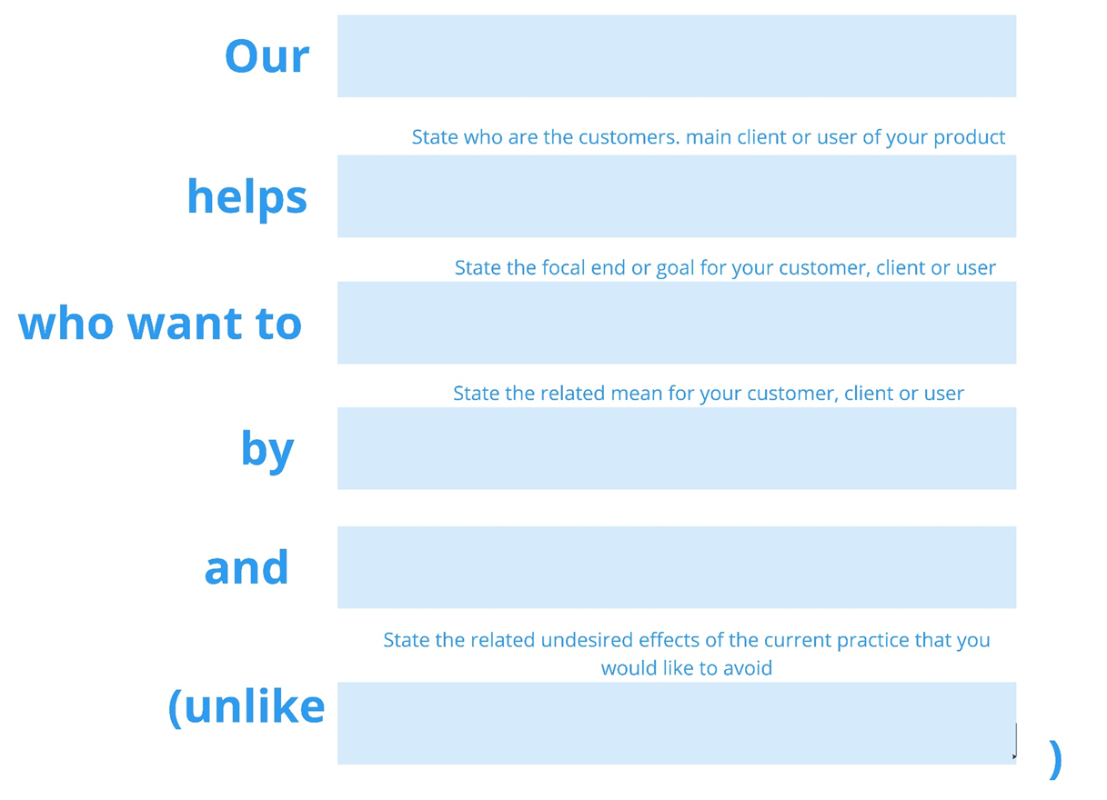
Communicate your value proposition
The value proposition is:
Our ocean thermal energy converter,
helps beach resort hotels
who want to offer good services and luxury to their tourists, such as ACs,
by having stable energy delivery
and low maintenance and low pollution
unlike being dependent on weather conditions
Notes:
https://blog.hubspot.com/marketing/write-value-proposition
For university research labs that are testing solar PV panels.
Who need testing equipment that accurately simulates solar spectrum
Our climate chamber
Is solar simulator
That provide unrivaled accuracy
Unlike all existing alternatives on the market
Our product uses steady-state sunlight with AAA-class accuracy
Inside climate chamber with integrated computer controlled system

Slide 32
Summary
-

